Slide 1
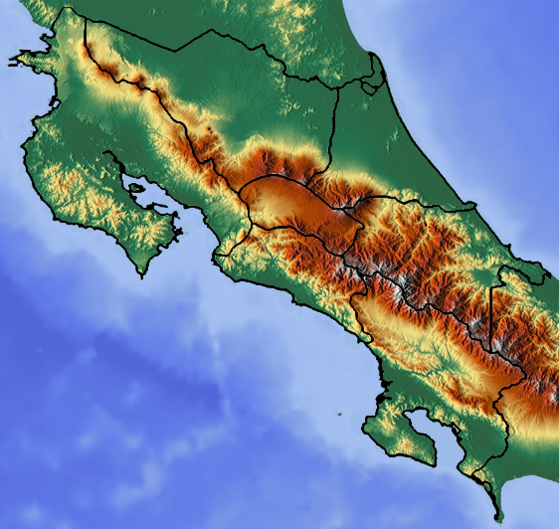
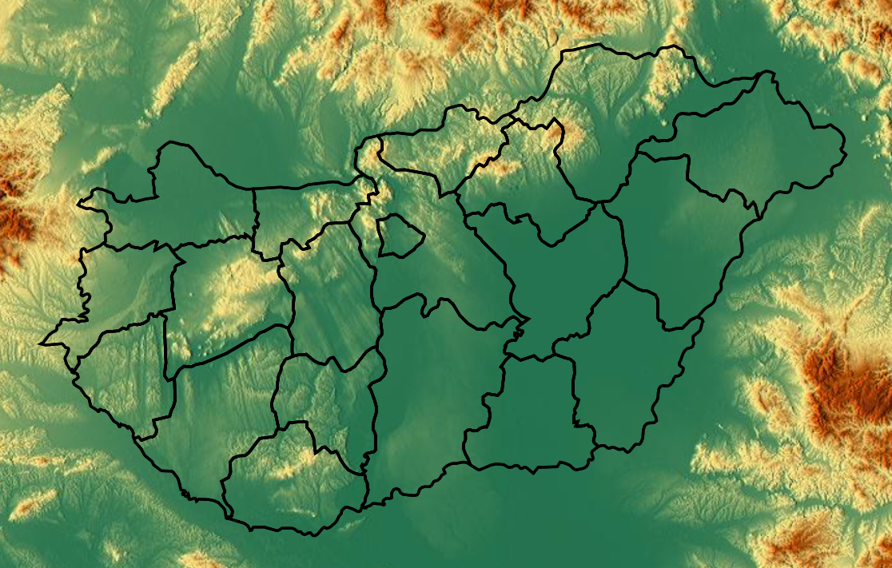
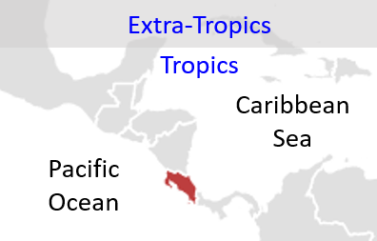
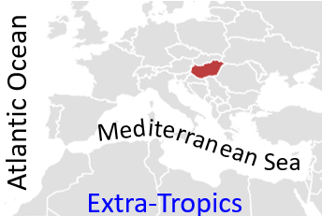
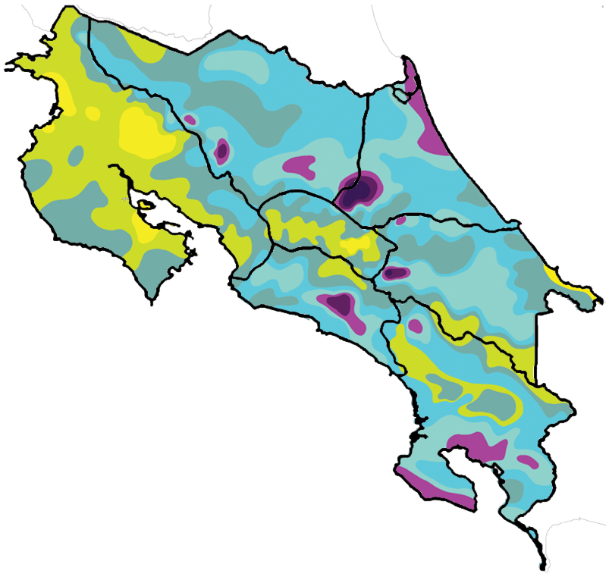
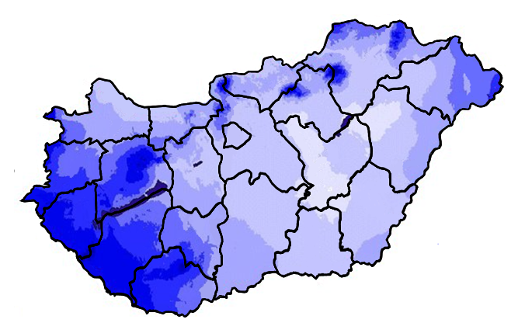


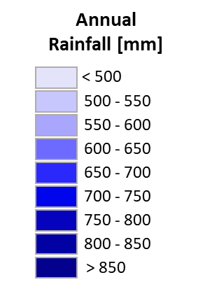
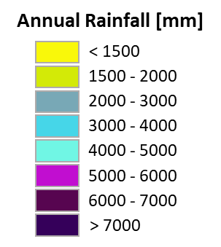
9000
a
b
Zona
Norte
5000
Pacífico Norte
3000
Caribe
Norte
Caribe
Sur
2000
X
Szilvásvárad
1000
0
Bükk mountains
m a.s.l.
Mátra
mountains
Nicoya Peninsula
Pacífico
Central
Pacífico
Sur
c
d

Slide 2
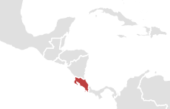
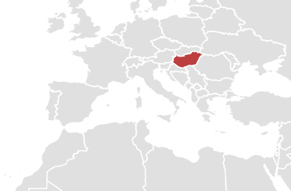
Extra-Tropics
Tropics
Caribbean
Sea
Atlantic Ocean
ite
Med
rran
ean
Pacific
Ocean
Sea
Extra-Tropics

Slide 3
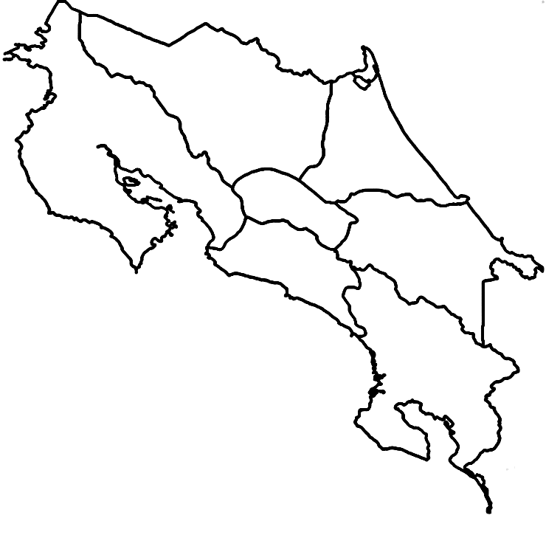

Slide 4
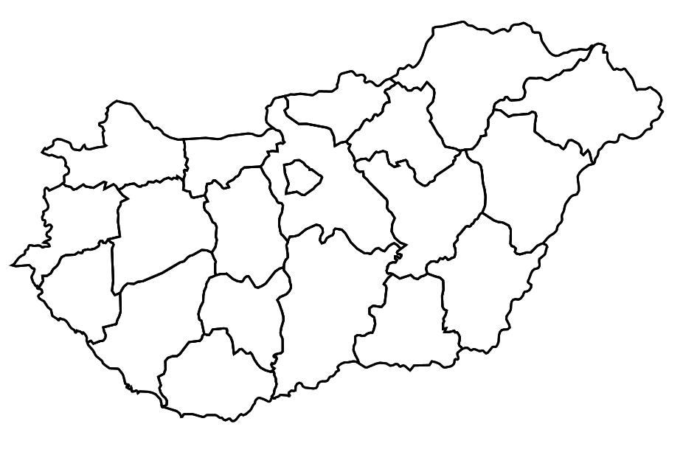

Slide 5
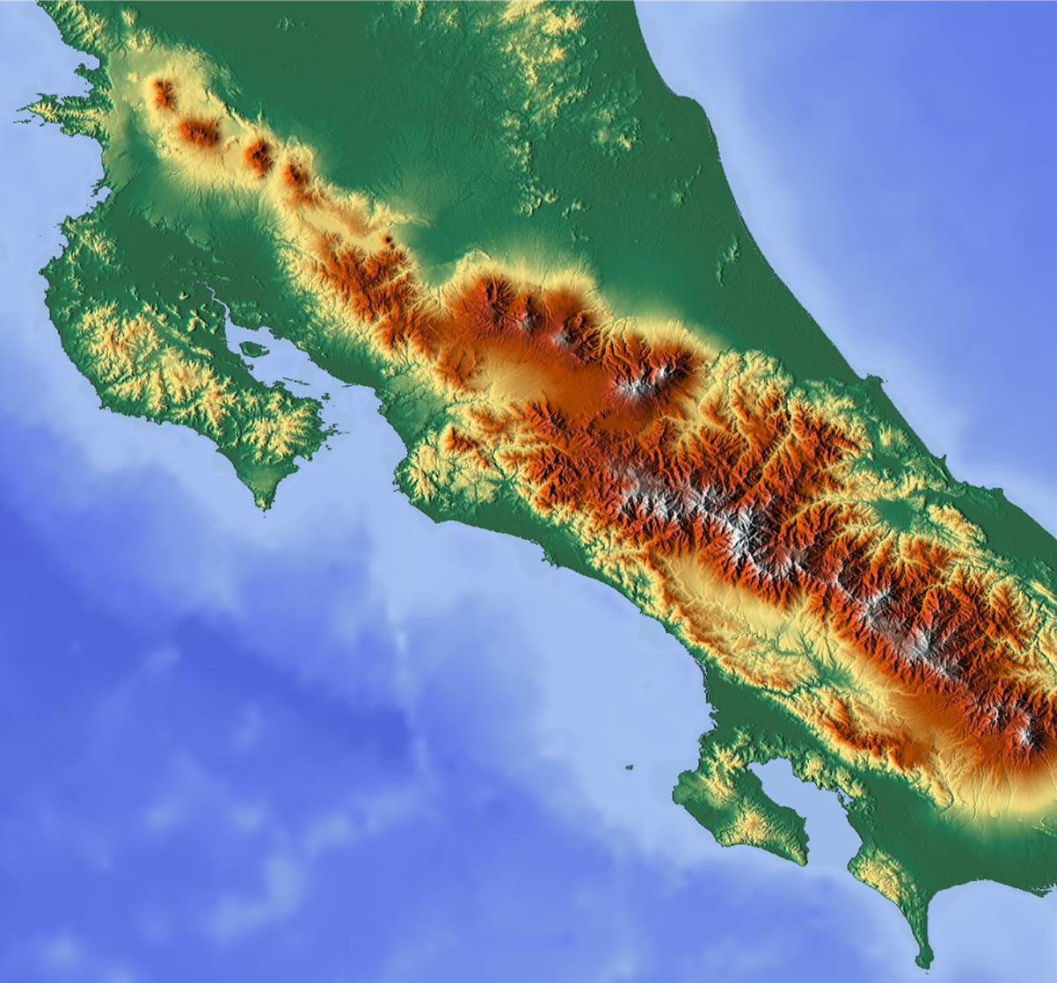
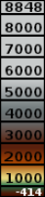
m.a.s.l.

Slide 6
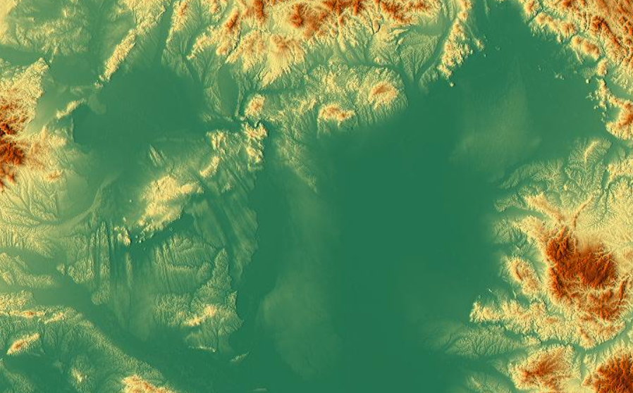
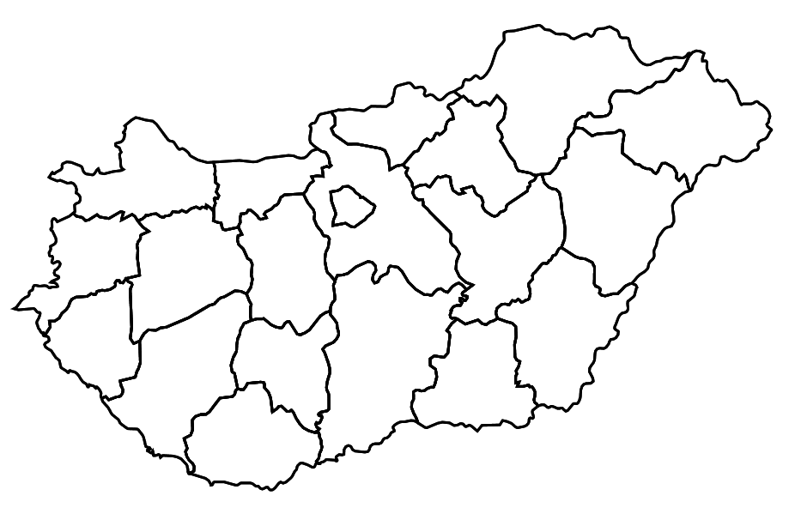

Slide 7
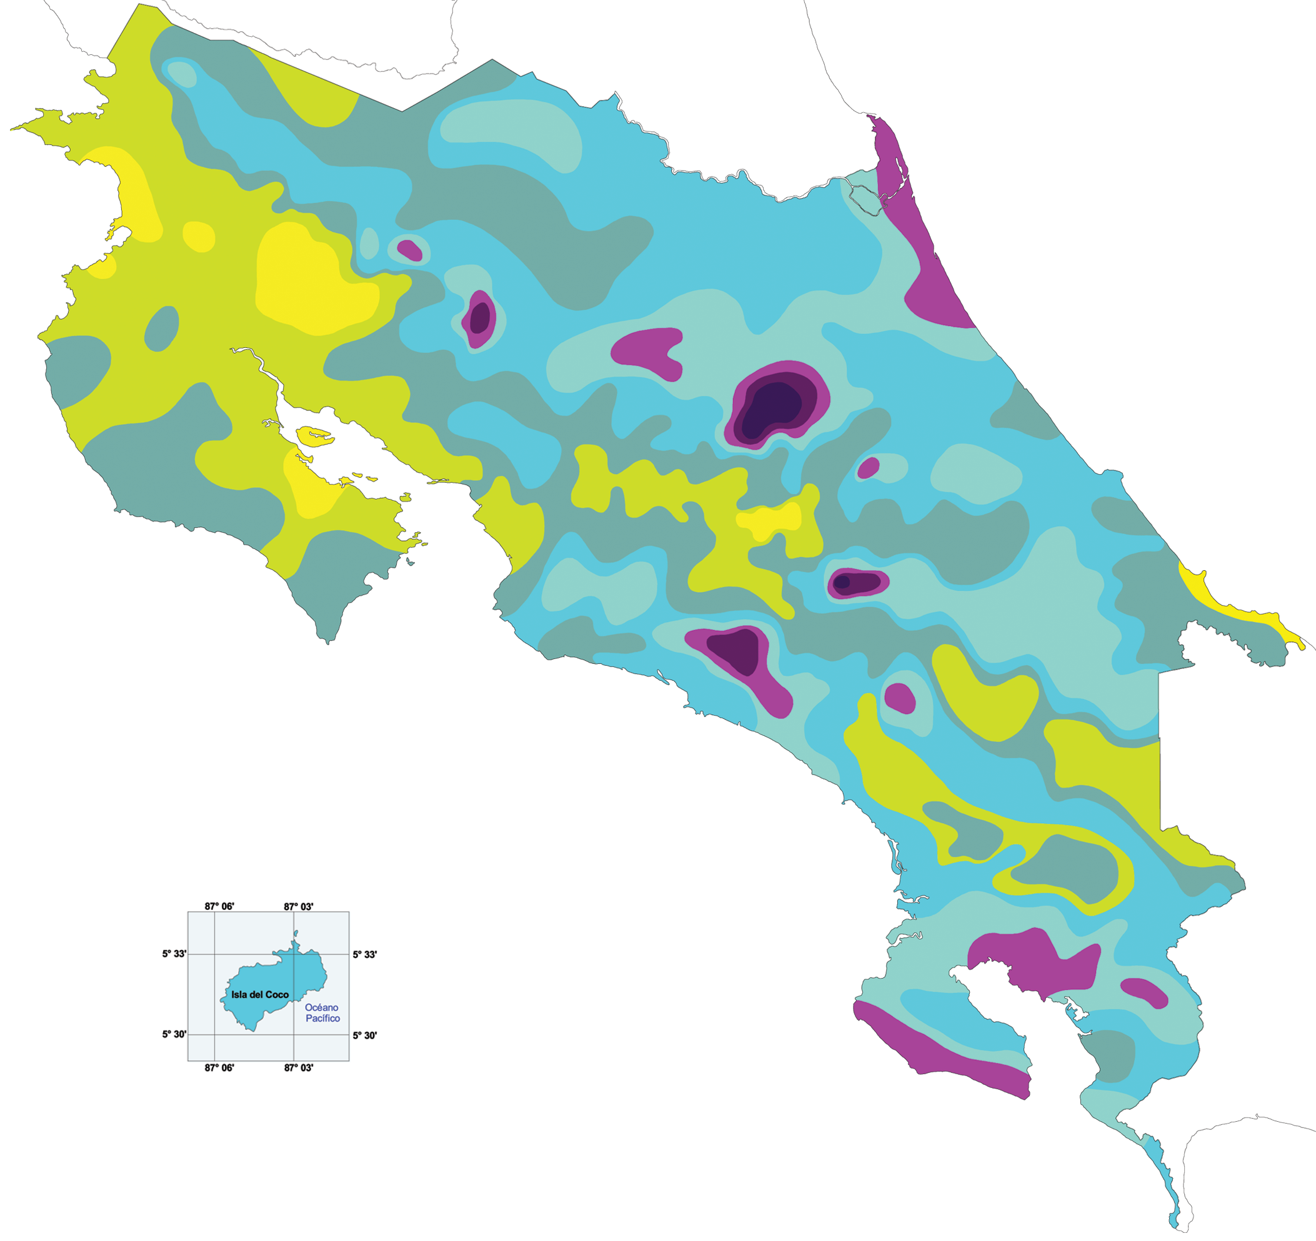
Annual Rainfall [mm]
< 1500
1500 - 2000
2000 - 3000
3000 - 4000
4000 - 5000
5000 - 6000
6000 - 7000
> 7000

Slide 8
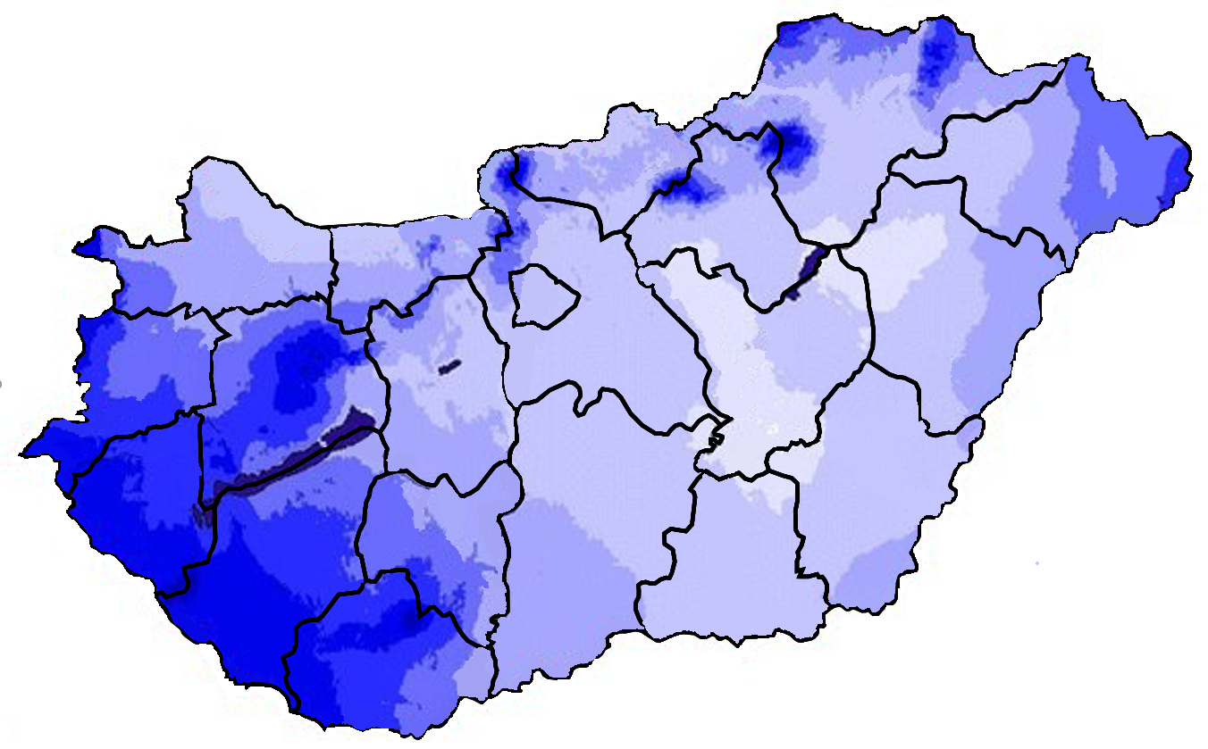
Annual
Rainfall [mm]
< 500
500 - 550
550 - 600
600 - 650
650 - 700
700 - 750
750 - 800
800 - 850
> 850

